Slide 1
Object-Oriented Systems Development:
Using the Unified Modeling Language
Chapter 12:
View Layer: Designing Interface Objects

Slide 2

Goals
Identifying View Classes
Designing Interface Objects
Guidelines to Graphical User Interface (GUI
. . . The design of your software's interface, more than anything else, affects how a user interacts and therefore experiences your application.
Tandy Trower

Slide 3

Designing View Layer Classes
The view layer classes are responsible for two major aspects of the applications:
Input-Responding to user interaction
Output-Displaying business objects

Slide 4
Relationships Among Business, Access and View Classes
In some situations the view class can become a direct aggregate of the access object, as when designing a web interface that must communicate with application/Web server through access objects.
View objects
Business objects
Access objects

Slide 5
Designing View Layer Classes (Con’t)
Design of the view layer classes are divided into the following activities:
  I. Macro Level UI Design Process- Identifying View Layer Objects.
  II. Micro Level UI Design Activities.
  III. Usability and User Satisfaction Testing.
  IV. Refine and Iterate.

Slide 6
View Layer Macro Level
1. For Every Class Identified
1.1 Determine If the Class Interacts With Human Actor: If yes, do next step otherwise move to next class.
  1.1.1 Identified the View (Interface) Objects for The Class.
  1.1.2 Define Relationships Among the View (Interface) Objects.
2. Iterate and refine.

Slide 7
View Layer Micro Level
1. For Every Interface Object Identified in the Macro UI Design Process.
  1.1 Apply Micro Level UI Design Rules and Corollaries to Develop the UI.
2. Iterate and refine.
Apply design rules and
GUI guidelines to
design the UI for the
interface objects
identified.

Slide 8
UI Design Rules
Rule 1- Making the Interface Simple
Rule 2- Making the Interface Transparent and Natural
Rule 3- Allowing Users to Be in Control of the Software

Slide 9
UI Design Rule 1
Making the Interface Simple (Rule 1)
KISS, Keep It Simple, Stupid.
Simplicity is different from being simplistic.
Making something simple requires a good deal of work and code.
Every additional feature potentially affects performance, complexity, stability, maintenance, and support costs of an application.
A design problem is harder to fix after the release of a product because users may adapt, or even become dependent on, a peculiarity in the design.

Slide 10
UI Design Rule 2
Making the interface transparent and Natural (Rule 2)
There should be strong mapping between the user's view of doing things and UI classes.
Making The Interface Natural
  The user interface should be intuitive so users can anticipate what to do next by applying their previous knowledge of doing tasks without a computer.
Using Metaphors
  Metaphors can assist the users to transfer their previous knowledge from their work environment to your application interface.
  For example, forms that users are accustomed to seeing.

Slide 11
UI Design Rule 3 [1]
Allowing users to be in control of the software (Rule 3)
Users should always feel in control of the software, rather than feeling controlled by the software.
Some of the ways to put users in control are:
  Making the interface forgiving.
  Making the interface visual.
  Providing immediate feedback.
  Avoiding Modes.
  Making the interface consistent.

Slide 12
UI Design Rule 3 [2]
Making the Interface Forgiving
  Users should be able to back up or undo their previous action.
  They should be able to explore without fear of causing an irreversible mistake.
Making the Interface Visual
  You should make your interface highly visual so users can see, rather than recall, how to proceed.
  Whenever possible, provide users with a list of items from which they can choose.
Providing Immediate Feedback
  Users should never press a key or select an action without receiving immediate visual feedback, audible feedback, or both.

Slide 13
UI Design Rule 3 [3]
Avoiding Modes
  Users are in a mode whenever they must cancel what they are doing before they can do something else.
  Modes force users to focus on the way an application works, instead of on the task they want to complete.
Can Modes be useful? Yes, however:
  You should make modes an exception and limit their use.
  Whenever users are in a mode, you should make it obvious by providing good visual cues.
  The method for ending the mode should be easy to learn and remember.
Mode Alternatives
  Modal Dialog
  Spring-Loaded Modes ( eg. using a mouse to cut and paste)
  Tool-Driven Modes (eg. the modes in TogetherJ)

Slide 14
UI Design Rule 3 [4]
Making the Interface Consistent
  User Interfaces should be consistent throughout the applications.
  For example, keeping button locations consistent make use feel in control.

Slide 15
Purpose of a User Interface
Data Entry Windows: Provide access to data that users can retrieve, display, and change in the application.
Dialog Boxes: Display status information or ask users to supply information.
Application Windows (Main Windows): Contain an entire application that users can launch.

Slide 16

Guidelines For Designing Data Entry Windows
You can use an existing paper form such as a printed invoice form as the starting point for your design.

Slide 17
Guidelines For Designing Data Entry Windows (Con’t)
If the printed form contains too much information to fit on a screen:
Use main window with optional smaller Windows that users can display on demand, or
Use a window with multiple pages.

Slide 18
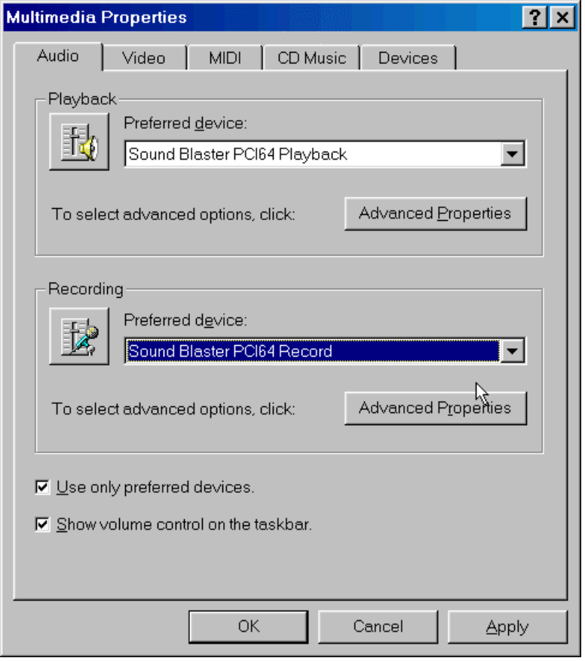
Guidelines For Designing Data Entry Windows (Con’t)
An example of a dialog box with multiple pages in the Microsoft multimedia setup.

Slide 19

Guidelines For Designing Data Entry Windows (Con’t)
Users scan a screen in the same way they read a page of a book, from left to right, and top to bottom.

Slide 20
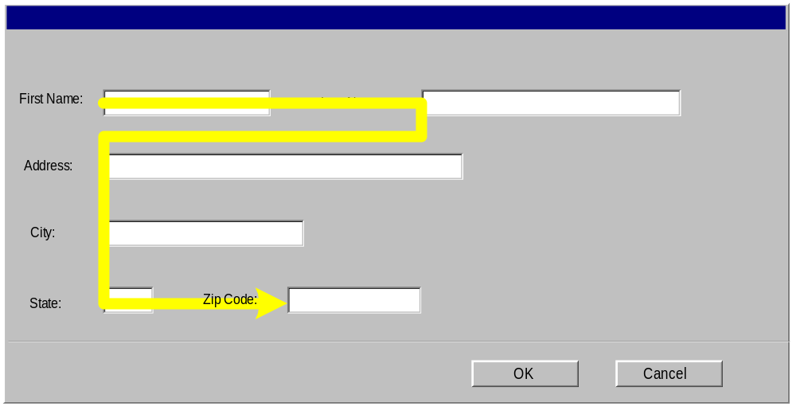
Guidelines For Designing Data Entry Windows (Con’t)
Orient the controls in the dialog box in the direction people read.
In the Western world this usually means left to right, top to bottom.

Slide 21
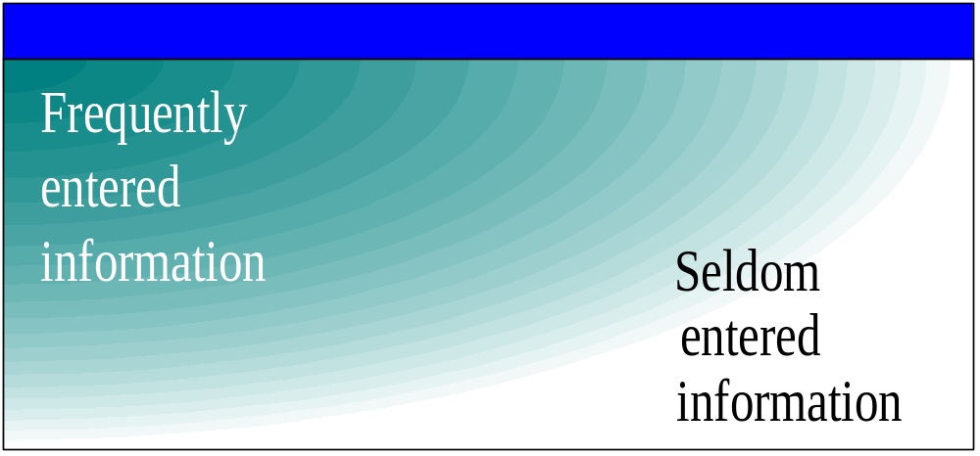
Guidelines For Designing Data Entry Windows (Con’t)
Required information should be put toward the top and left side of the form, entering optional or seldom entered information toward the bottom.

Slide 22
Guidelines For Designing Data Entry Windows (Con’t)
Place text labels to the left of text box controls, align the height of the text with text displayed in the text box.
Possible locations for text
Labels
Label
Label

Slide 23
Guidelines For Designing Dialog Boxes
If the dialog box is for an error message, use the following guidelines:
Your error message should be positive.
For example instead of displaying “You have typed an illegal date format,” display this message “Enter date format mm/dd/yyyy.”

Slide 24
Guidelines For Designing Dialog Boxes(Con’t)
Your error message should be constructive, brief and meaningful.
For example, avoid messages such as
  “You should know better! Use the OK button”
instead display
  “Press the Undo button and try again.”

Slide 25
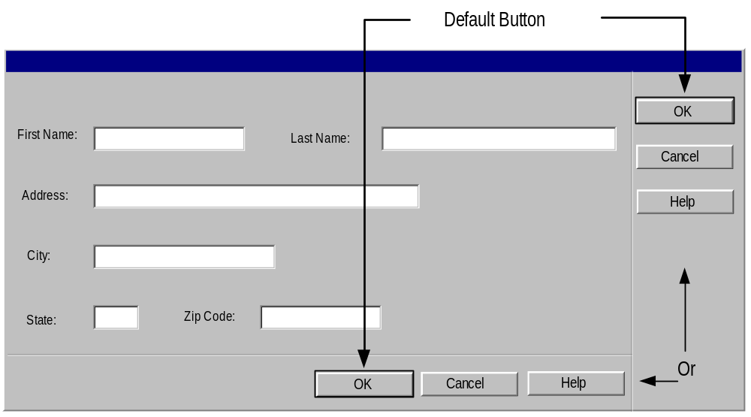
Guidelines For The Command Buttons Layout
Arrange the command buttons either along the upper-right border of the form or dialog box or lined up across the bottom.

Slide 26
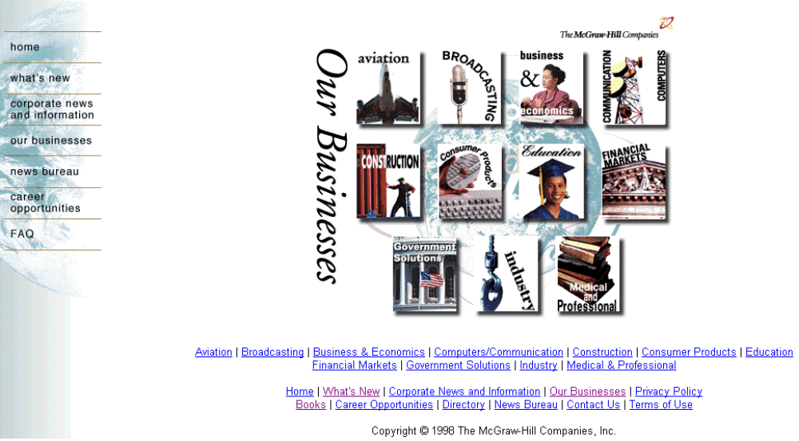
Buttons Layout (Con’t)
Positioning buttons on the left or center is popular in Web interfaces.

Slide 27
Guidelines For Designing Application Windows
A typical application window consists of a frame (or border) which defines its extent:
title bar
scroll bars
menu bars,
toolbars, and
status bars.

Slide 28
Guidelines For Using Colors [1]
Use identical or similar colors to indicate related information.
Use different colors to distinguish groups of information from each other.
For example, checkout and in-stock tapes could appear in different colors.
For an object background, use a contrasting but complementary color.
For example, in an entry field, make sure that the background color contrasts with the data color.
Use bright colors to call attention to certain elements on the screen.

Slide 29
Guidelines For Using Colors [2]
Use dim colors to make other elements less noticeable.
For example, you might want to display the required field in a brighter color than optional fields.
Use colors consistently within each window and among all Windows in your application.
For example the colors for Pushbuttons should be the same throughout.
Using too many colors can be visually distracting, and will make your application less interesting.
Allow the user to modify the color configuration of your application.

Slide 30
Guidelines For Using Fonts
Use commonly installed fonts, not specialized fonts that users might not have on their machines.
Use bold for control labels so they will remain legible when the object is dimmed.
Use fonts consistently within each form and among all forms in your application.
For example, the fonts for check box controls should be the same throughout.
Consistency is reassuring to users, and psychologically makes users feel in control.
Using too many font styles, sizes and colors can be visually distracting and should be avoided.

Slide 31
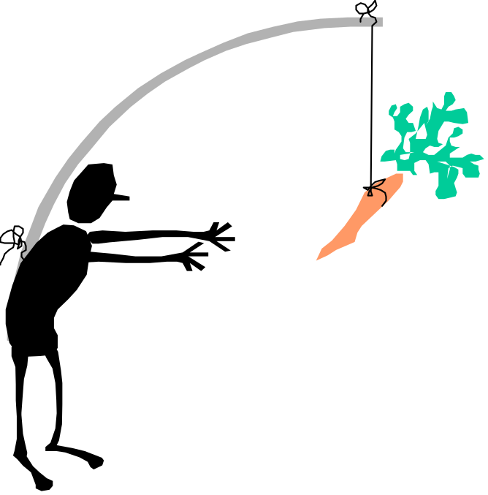
Prototyping the User Interface
Rapid prototyping encourages the incremental development approach, “grow, don’t build.”
Notes:
Prototyping involves a number of iterations. Through each iteration we add a little more to our application and, as we understand the problem a little better, we can make more improvements.

Slide 32
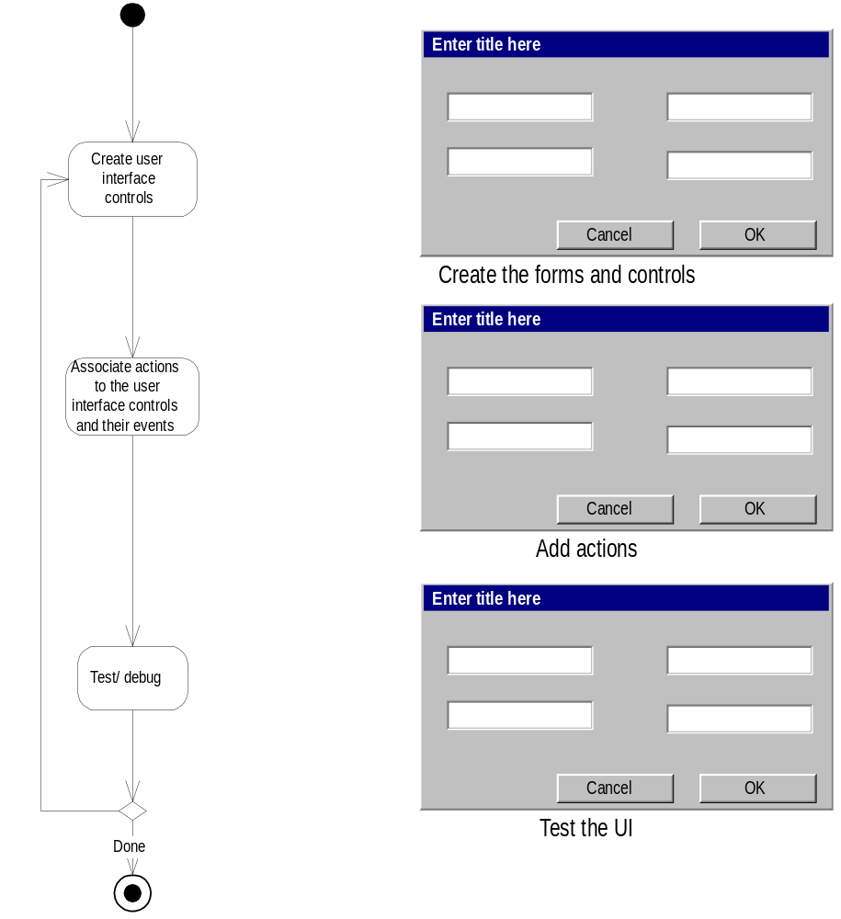
Three General Steps
1. Create the user interface objects visually.
2. Link or assign the appropriate behaviors or actions to these user interface objects and their events.
3. Test, debug, then add more by going back to step 1.

Slide 33

Make Users Feel in Charge
Instead of using leading phrases like,
  "we could do this ..." or "It would be easier if we ..."
Choose phrases that give the user the feeling that he/she is in charge:
  “Do you think that if we did ... it would make it easier for the users?” “Do users ever complain about ...? We could add .. to make it easier.”

Slide 34
Summary [1]
The main goal of UI is to display and obtain information you need in an accessible, efficient manner.
The design of your software's interface, more than anything else, affects how a user interacts and therefore experiences your application.
UI must provide users with the information they need and clearly tell them what they need to successfully complete a task.
A well-designed UI has visual appeal that motivates users to use your application.
UI should use limited screen space efficiently.

Slide 35
Summary [2]
Designing View layer classes consists of the following steps:
  I. Macro Level UI Design Process- Identifying View Layer Objects
  II. Micro Level UI Design Activities
  II.1 Designing the View Layer Objects by applying Design Axioms and corollaries .
  II. 2 Prototyping the View Layer Interface.
  III. Usability and User Satisfaction Testing
  IV. Refine and Iterate
Guidelines are not a standalone tool, and they cannot substitute for effective evaluation and iterative refinement within a design.
However, they can provide helpful advice during the design process.

